Slide 1
Aberdeen Slide Master
Standard templates and style guide
July 2025

Slide 2
Style Guide
Link to Style Guide Folder: New Branding - Style Guide and Logos
Primary Brand Colors
ADA Compliant Color Combinations
High contrast
Use white or Aberdeen Teal on Aberdeen Blue background
Use Aberdeen Blue or Black text on an Aberdeen Teal background
Abderdeen Blue
#09375F
Aberdeen Teal
#44B0B1
Onyx
#404040
White
#FFFFFF
Use Aberdeen Blue, Onyx, or Black text on a white background
Secondary Brand Colors
Non-Compliant Color Combinations
Low Contrast
Using White text on an Aberdeen Teal Background
Deep Sky Blue
#5CC8FF
Jade
#00A676
Jasper
#DB504A
Gold
#F7D002
Using Aberdeen Teal text on a white background

Slide 3
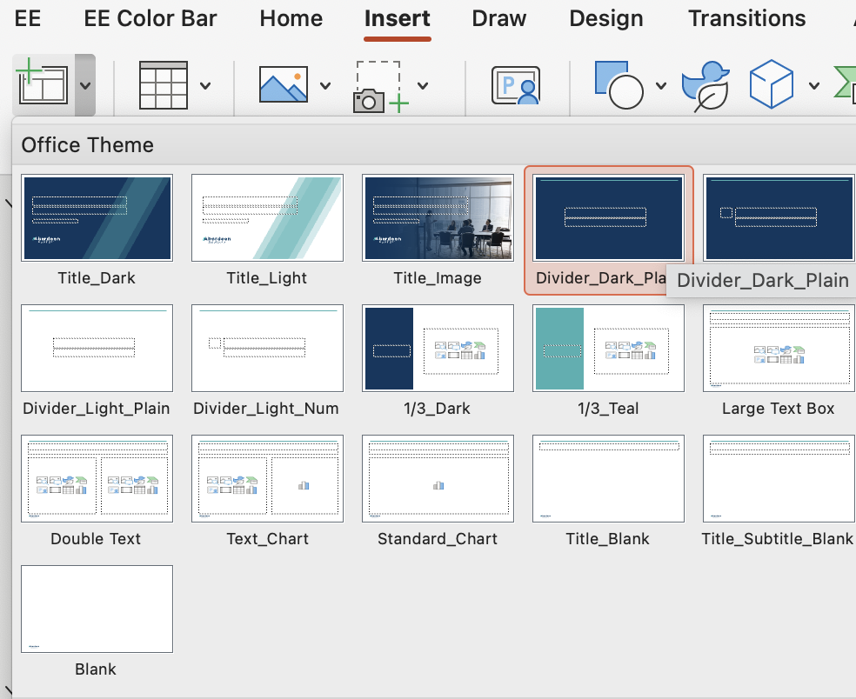
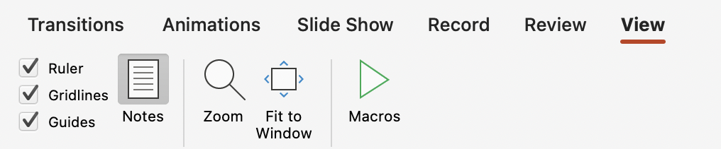
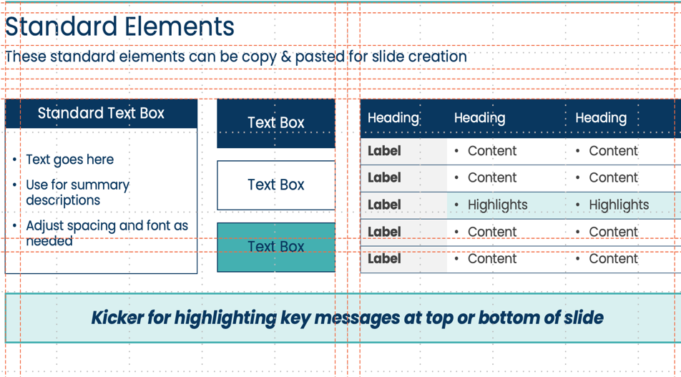
Using this slide master
To add standard slide templates:
insert > New Slide (down arrow)
To display guides & grids:
View > Check Gridlines / Guides
1
1
2
2

Slide 20
Standard Elements
These standard elements can be copy & pasted for slide creation
Standard Text Box
Text Box
Heading | Heading | Heading
Label | Content | Content
Label | Content | Content
Label | Highlights | Highlights
Label | Content | Content
Label | Content | Content
Text goes here
Use for summary descriptions
Adjust spacing and font as needed
Text Box
Text Box
Kicker for highlighting key messages at top or bottom of slide

Slide 21
Sample 6 week plan
Sample layout for project workplan
Phase 1: Name
Phase 2: Name
 | Week 1 | Week 2 | Week 3 | Week 4 | Week 5 | Week 6
 | Discover | Synthesize | Ideate | Define | Plan | Deliver
Activities | X X X | X X X | X X X | X X X | X X X | X X X
Outputs | X X X | X X X | X X X | X X X | X X X | X X X

Slide 22
Sample Workstream Planning
Sample layout for workstream plan
# | Activity | Description
1 | Activity | Description
2 | Activity | Description
3 | Activity | Description
4 | Activity | Description
5 | Activity | Description
6 | Activity | Description
Success Factors
1
Success Factor
Description
2
Success Factor
Description
3
Success Factor
Description

Slide 23
Sample Org Chart
Sample layout for an Organizational structure / Org Design
Name
Position / Title
Name
Position / Title
Name
Position / Title
Name
Position / Title
Name
Position / Title
Name
Position / Title
Name
Position / Title
Name
Position / Title
Name
Position / Title
Name
Position / Title
Name
Position / Title
Name
Position / Title
Name
Position / Title

Slide 24
































































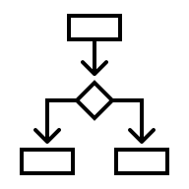











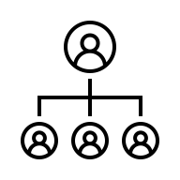
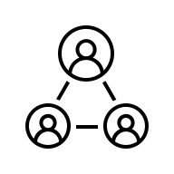





















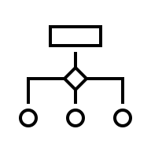













































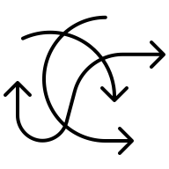
Iconography
Utilize Microsoft icons where possible for consistency and ease
Sentiment
Wayfinding
Comms
KPI / Measure
Tech
Security
Road Signs
Ideas
Process & Ops
People & Org
Time & Cal
Search / Filter
Growth
Misc
Lists & Docs
Reference
Commerce
Vibes

